Slide 1
Hashing
Lesson 7

Slide 2
Motivation
Suppose we have 16,000,000 data items. We would like to be able to find a particular item. – How long will it take to find the item? 
It depends on the data structure.

Slide 3
Motivation
If the data structure is a linked list and items are not sorted, the search time is O(N).
If the data structure is a linked list and items are sorted, the search time of a binary search is O(log₂ N ).
log₂ 16,000,000 ≈ 24

Slide 4
Motivation…
Can we do even better than O(log₂ N )?
Yes we can. We can use “hash” functions.

Slide 5
Comparison-based Searches
To locate an item, the target search key has to be compared the other keys in the collection.
O(log n) is the best that can be achieved
We must use a different technique if we want to improve the search time

Slide 6
Hashing
The process of mapping a search key to a limited range of array indices
The goal of providing direct access to the keys
Hash table – the array containing the keys
Hash function – maps a key to an array index

Slide 7
Hashing example
Suppose we have the following set of keys
765, 431, 96, 142, 579, 226 903, 388
And a hash table, T, with M = 13 elements
We can define a simple hash function h() h(key) = key % M

Slide 8

Adding Keys
To add a key to the hash table:
Apply the hash function to determine the array index which the key should be stored.
h(765) => 11
h(431) => 2
h(96) => 5
h(142) => 12
h(579) => 7
Store the key in the given slot.

Slide 9
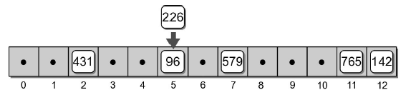
Collisions
What happens when we attempt to add key 226?
h(226) => 5
Collision – when two or more keys map to the same hash location.

Slide 10
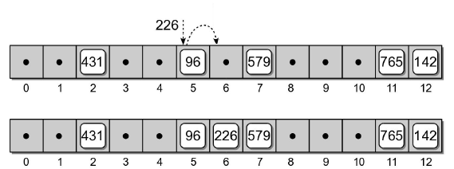
Probing
If two keys map to the same table entry, we must resolve the collision to find another available slot.
Linear probe – simplest approach which examines the table entries in sequential order

Slide 11
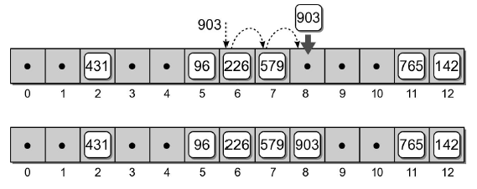
Probing
Consider adding key 903 to our hash table
h(903) => 6

Slide 12
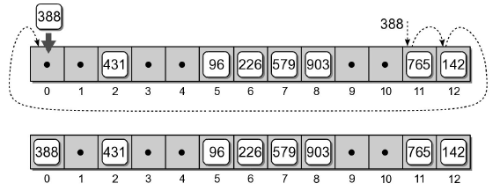
Probing
If the end of the array is reached during the probe, it wraps around to the first entry and continues.
Consider adding key 388 to our hash table.
h(388) => 11

Slide 13
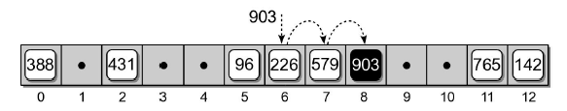
Searching
Searching a hash table for a specific key is very similar to the add operation
Target key is mapped to an initial slot
See if the slot contains the target
Otherwise, apply the same probe used to add keys to locate the target.
Example: search for key 903

Slide 14
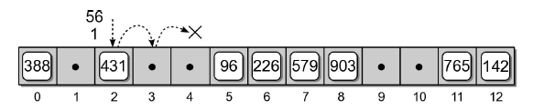
Searching
What if the key is not in the hash table?
The probe continues until either:
A null reference is reached, or
All slots have been examined.

Slide 15
Deleting Keys
Deleting a key from a hash table is a bit more complicated than adding keys.
We can search for the key to be deleted
But we cannot simply remove it by setting the entry to None

Slide 16

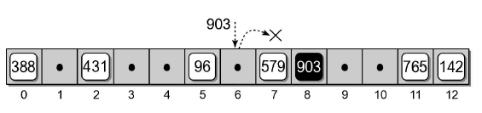
Incorrect Deletion
Suppose we simply remove key 226 from slot 6.
What happens if we search for key 903?

Slide 17

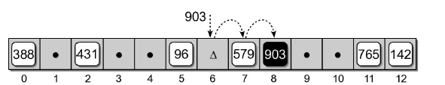
Correct Deletion
We use a special flag to indicate the entry is now empty, but was previously occupied
When searching a hash table, the probe must continue past the slot(s) with the special flag

Slide 18
Clustering
The grouping of keys in a common area.
As more keys are added to the hash table, more collisions are likely to occur
Clusters begin to form due to the probing required to find an empty slot.
As a cluster grows larger, more collisions will occur.
Primary clustering – clustering around the original hash position.

Slide 19
Probe Sequence
The order in which the hash entries are visited during the probe.
The linear probe steps through the entries in sequential order
The next array slot can be represented as
slot = (home + i) % M
Where
i is the i^{th} probe
home is the home position

Slide 20

Modified Linear Probe
We can improve the linear probe by changing the step size to some fixed constant
slot = (home + i * c) % M
Suppose we set c = 3 to build the hash table
h(765) => 11 h(579) => 7
h(431) => 2 h(226) => 5 => 8
h(96) => 5 h(903) => 6
h(142) => 12 h(388) => 11 => 1

Slide 21

Quadratic Probing
A better approach for reducing primary clustering
Increases the distance between each probe in the sequence
Example
slot = (home + i**2) % M
h(765) => 11 h(579) => 7
h(431) => 2 h(226) => 5 => 6
h(96) => 5 h(903) => 6 => 7 => 10
h(142) => 12 h(388) => 11 => 12 => 2 => 7 => 1

Slide 22

Quadratic Probing
Reduces the number of collisions
Introduces the problem of secondary clustering
When two keys map to the same entry and have the same probe sequence
Example: add key 648
Hashes to entry 11
Follows the same sequence as key 388

Slide 23
Double Hashing
When a collision occurs, a second hash function is used to build a probe sequence.
Step size remains a constant throughout the probe
Multiple keys that have the same home position, will have different probe sequence
slot = (home + i * hp(key)) % M

Slide 24

Double hashing
A simple choice for the second hash function
hp(key) = 1 + key % P
Example: let P = 8
h(765) => 11 h(579) => 7
h(431) => 2 h(226) => 5 => 8
h(96) => 5 h(903) => 6
h(142) => 12 h(388) => 11 => 3
Notes:
(226%13) + 1*(1+226%8)
((388%13) + 1*(1+388%8)) % 13

Slide 25
Table Size
How big should a hash table be?
If we know the max number of keys
Create it big enough to hold all of the keys
In most instances, we don’t know the number of keys
Most probing techniques work best when the table size is a prime number

Slide 26
Rehashing
We can start with a small table and expand it as needed
Similar to the approach used with the dynamic array
Load factor – the ration between the number of keys and the size of the table
A hash table should be expanded before the load factor reaches 80%

Slide 27


Rehashing Example
After creating a larger array for the table, we cannot simply copy the original keys to the new table
We must rebuild or rehash the entire table.
h(765) => 0 h(579) => 1
h(431) => 6 h(226) => 5
h(96) => 11 h(903) => 2
h(142) => 6 => 7 h(388) => 14

Slide 28
Expansion Size
Size of the expansion depends on the application
Good rule of thumb is to at least double its size
Two common approaches:
Double the size of the table, then search for the first larger prime number
Double the size of the table, and add one to ensure M is odd

Slide 29
Efficiency Analysis
Depends on
The hash function
Size of the table
Type of collision resolution probe
Once an empty slot is located, adding or deleting a key can be done in O(1) time
The time required to perform the search is the main contributor to the overall time of all ops

Slide 30
Efficiency Analysis
Best case: O(1)
The key maps directly to the correct entry
There are no collisions
Worst case: O(m)
Assume there are n keys stored in a table of size m
The probe has to visit every entry in the table

Slide 31
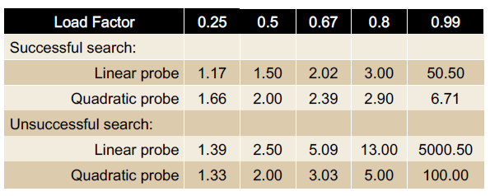
Efficiency Analysis
While hashing appears to be no better than a basic linear search, hashing is very efficient in the average case

Slide 32
Separate Chaining
We can eliminate collisions altogether if we store the keys outside the table
Chains – use linked lists to store keys that map to the same entry
The hash table becomes an array of linked lists
After mapping the key to an entry in the table, the linked list is searched for the key

Slide 33
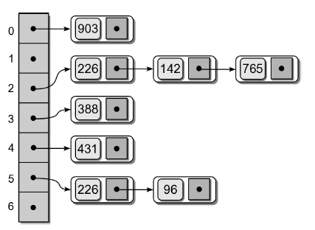
Separate Chaining

Slide 34
Efficiency: Separate Chaining
Very efficient in the average case
If there are n keys and m entries, the average list length is
α = n/m
Successful search
1 + α/2
Unsuccessful search
1 + α

Slide 35
Hash functions
The efficiency of hashing depends in large part on the selection of a good hash function
A “perfect” function will map every key to a different table entry
This is seldoom achieved except in special cases [further reading]
A “good” hash function distributes the keys evenly across the range of table entries

Slide 36
Hash Function Guidelines
Important guidelines to consider in designing a hash function.
Computation should be simple
Resulting index cannot be random
Every part of a multi-part key should contribute
Table size should be prime number

Slide 37
Common Hash Functions
Division – simplest for integer values
Truncation – some columns in the key are ignored
Example: assume keys composed of 7 digits
Use the 1st, 3rd, 6th digits to form an index (M = 1000)

Slide 38
Common Hash Functions
Folding – key is split into multiple parts then combined into a single value
Given a key value 4873152, split it into three smaller values (48, 73, 152)
Add the values together and use with division

Slide 39
Hashing Strings
Strings can also be stored in a hash table.
Convert to an integer value that can be used with the division or truncation methods
Simplest approach: sum the ASCII values of individual characters.
Problem: Short strings will not hash to larger table entries
Better approach: use a polynomial
Notes:
Summing the ASCII values of individual characters
For example, if we use this method to hash the string 'hashing', the result will be:
104 + 97 + 115 + 104 + 105 + 110 + 103 = 738
>>> txt = "hashing“
>>> sum([ord(c) for c in txt])
738
This approach works well with small hash tables. But when used with larger
tables, short strings will not hash to the larger index values; they will only be used when probed.
Using polynomial
where a is a non-zero constant, s_{i} is the i^{th} element of the string, and n is the length of the string. If we use this method with the string 'hashing', where a = 27, the resulting hash value will be 41746817200.
txt = "hashing"
i = len(txt) - 1
result = 0
for c in txt:
result += ord(c) * (27**i)
i -= 1
print(result) #prints 41746817200
104*27^6 + 97*27^5 + 115*27^4 + 104*27^3 + 105*27^2 + 110*27^1 + 103*27^0 = 41746817200
This value can then be used with the division method to yield an index value within the valid range.

